Slide 1
EMPLOYEE ATTRITION PROBLEM
BY
RIDWANULLAH IBRAHIM ABIODUN
PROJECT PROBLEM STATEMENT
(PROOF OF CONCEPT)
HASH ANALYTIC
JUNE, 2020.

Slide 2
PROBLEM STATEMENT
Employee Attribution is the gradual reduction in numbers of staff that occurs as employees retire or resign and are not replaced.
When companies do not offer advancement and development opportunities for capable and ambitious workers, they may end up losing talented employees and retaining poor performance.

Slide 3
REVIEW
Causes of employee attrition:
Employment engagement
High level of stress and lack of work-life balance
Promotion and progression.
Health and age problem, etc.
Effects of employee attribution includes:
Low productivity
Loss of knowledge
Excess workload
Cost

Slide 4
OBJECTIVE
This project is about a company’s employee attrition case. So, my aim is to determine:
Why employees are leaving the company?
Which employees are prone to leave the company?

Slide 5
METHODOLOGY
Data Insights
I was given two datasets; Existing Employees and Employees who have left. I created a column with the name – Left - in each of these data. The column has all it entries equal ‘Yes’ in the Existing Employees data, and all it entries equal ‘No’ in the Ex-Employees data. I combining these two data produce a universal dataset.
The universal dataset has 14,999 samples with 11,428 samples of existing employees and 3,571 samples of employees who have left the company. The data has 11 attributes with the first attribute (Emp_ID) being a unique attribute given to each employee. So, it does not determine whether an employee leaves or stays in the company. The remaining 10 attributes are: satisfaction level, last evaluation, number project, average monthly hours, time spend company, Work accident, promotion last 5years, dept, salary, and left.

Slide 6
Methodology contd…
satisfaction level: level of interest of an employee in the job/work
last evaluation: performance of an employee evaluated by the probably employer
number project: number of projects/assignments assigned to an employee (engagement of an employee)
average monthly hours: average number of hours an employee uses to work in a month
time spend company: the number of year an employee has spent with the company (experience years)
Work accident: whether an employee had work accident or not
promotion last 5years: whether an employee has had a promotion within the last 5 years or not
dept: this tells us the section or department where the employee is working.
salary: is the salary level of the employee, which is either low, medium or high.
left: whether the employee has left the company with Yes and No.

Slide 7
Methodology contd…
By comparing the characteristic of the two given dataset with respect to their attributes, I was able to study the features of those employees that left the company to those who stayed.
Left | Satisfaction level | Last evaluation | Number project | Average monthly hours | Time spend company | Work accident | Promotion last 5years
No | 0.666810 | 0.715473 | 3.786664 | 199.060203 | 3.380032 | 0.175009 | 0.026251
Yes | 0.440098 | 0.718113 | 3.855503 | 207.419210 | 3.876505 | 0.047326 | 0.005321
From the table, I observe that, the employees who left the company has low satisfaction level, low promotion, low salary and high working hours compared to the employees who are remained in the company.

Slide 8
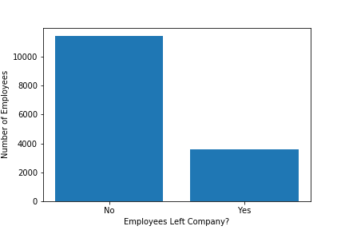
Methodology contd…
Data Visualization
The chart below compares the number of those that left the company to those that stayed.
We can see that out of 14,999 employees, 3,571 had left and 11,428 stayed. That is, the number of employee left is 23.80% of the total employees.

Slide 9
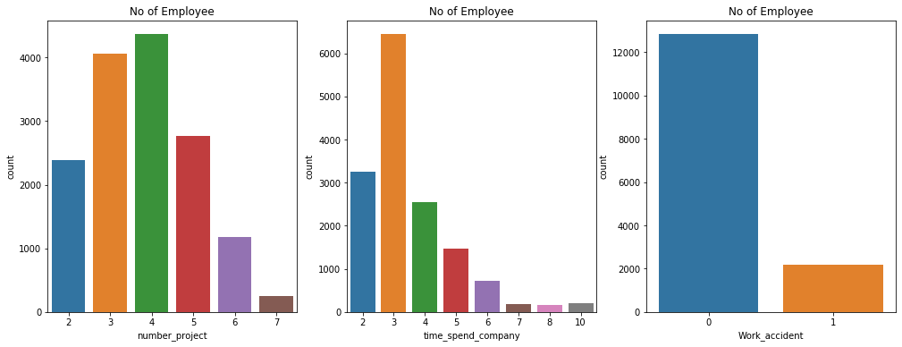
Methodology contd…
The figures below show the visualization of each attribute with respect to the number of employee performing the attribute.
Most of the employees work on projects from 3-5.
Most of the employees experience is between 2-4 years. Also, there is a massive
difference between the employees who are 3 years experienced and 4 years.
Most of employees did not have worked accident.

Slide 10
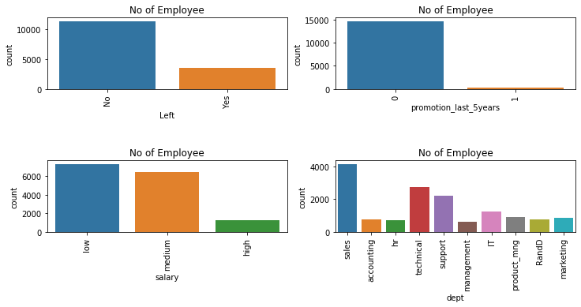
Methodology contd…
23% of the total employees have left.
Most of the employees did not get promotion in the last 5 years.
Most of the employees are getting salary either low or medium.
Most of the employees are in the sales department followed by technical, then support

Slide 11
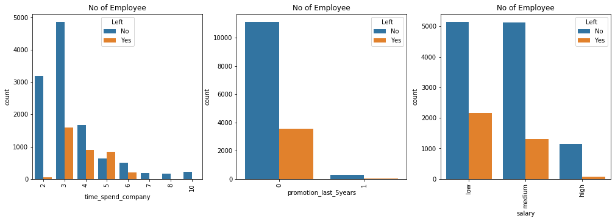
WHY ARE EMPLOYEES LEAVING THE COMPANY?
Let compare all these attributes between the existing employees and the ex-employees.
The employees with 5 years experience is leaving more because of no promotion in last 5 years, and more than 6 years are staying because of affection with the job/company.

Slide 12
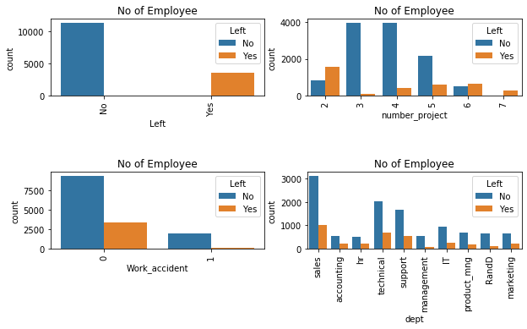
The employees who have the number of projects less than 3 and greater than 5 left the company because it seems they were overloaded with work.
Looking at the work accident and department, employees are leaving probably because of no affection with either the job or the company.

Slide 13
WHICH EMPLOYEES ARE PRONE TO LEAVE THE COMPANY?
From the analysis and visualization that I have done so far, the following features are most influencing a person to leave the company:
Promotions: Employees are more likely to leave the company if they did not receive a promotion in the last 5 years.
Salary: Most of the employees that leave the company are among the low or medium salary.
Number of Projects: Employment engagement is also an important factor influencing employees to leave. Employees with 3 -5 projects are less likely to leave.
Time spent Company: The third – year is an important factor influencing the employee to leave the company.

Slide 14
RESULT
After building the prediction for the company attrition case, I evaluate the performance of the model. I got an accuracy of 97.89% .

Slide 15
CONCLUSION
The few recommendations that has to be followed by the employer to the employees are:
Orientation program
Recognition and rewards system
Communication and feedback
Work-life balance

Slide 16
Code link: https://github.com/Captain-Dende/Company-s-Attrition-case/blob/main/Code%20File.ipynb

